Slide 1

Report for BFX-AT100 - Dec 2022 Mass Production Inspection
FOXCONN CPEG JBD_VN
Jan 03, 2023

Slide 2
Establish the Team
Team Leader
Team Member
PE: Michael, Nam
ME: Cheng Lun, Hugo
PM: An Tran, Yuri
PD: Wen Yong
QA: Ken, Robert
TE: Mark, Jones
IE: Hai Ly, Heng Ruan
Foxconn
  MFG Manager : David Yin
  QA Manager : Toney Tu/ CB Lin

Slide 3
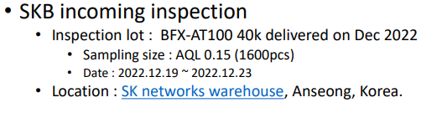
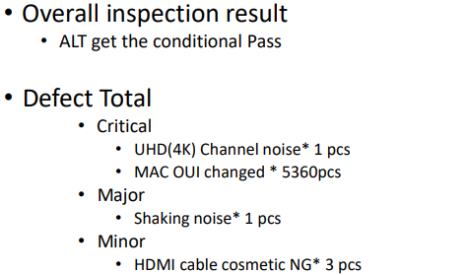
Description of Problems
Issue Description
On Dec 27, 2022 ALT customer feedback about Mass Production Inspection for shipment lots in Dec-2022 Detail as below:

Slide 4


Failure Analysis Report
1. UHD(4K) Channel noise
Root cause.
Check production data and logs test didn’t find any Abnormal detail as attached file.
Waiting NG unit returns factory for further analysis.
Actions
Waiting analysis result to give corresponding actions.
No# | Station | Status | Test log
1 | FT (test HDMI video noise) | PASS

Slide 5
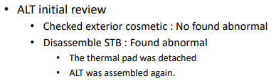
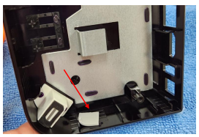
Failure Analysis Report
2. Shaking Noise
2.1 Description problem.
ALT customer feedback that detected 1/1600 unit (0.06%) has noise when shaking product, then he opened the product and found the thermal pad was detached, detail as below:

Slide 6

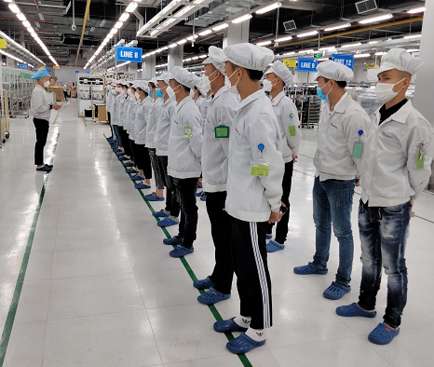
Failure Analysis Report
2. Shaking Noise
2.2 Root cause
After ALT customer was opened housing and detected the thermal pad was detached, he pasted thermal pad in it’s location and shaken unit again and didn’t find noise issue.
Therefore, it maybe due to operator take housing on hand with an angle about 70 degrees to assemble PCBA into housing, it leads to thermal pad drop out of it’s location and have noise when shaking product.
2.3 Actions
Add notice in SOP and Re-train operators, “Must be assemble PCBA into housing on the table, don't take on hand to assemble”. (Done)
Remind and re-train operators must careful and focus on work. (Done)
Remind and re-train operators

Slide 7
Failure Analysis Report
3. The HDMI cable cosmetic NG.
Root cause.
SQE send mail and request supplier provide report for this issue.(Due date: Dec 06, 2022)
Actions
Waiting analysis result to give corresponding actions.

